Slide 1
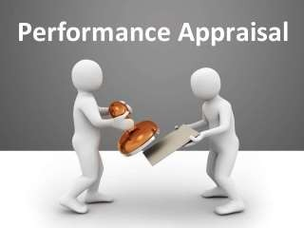
Performance Appraisal.
“Performance appraisal is a systematic appraisal of the employee’s personality traits and performance on the job and is designed to determine his
contribution and relative worth to the firm”
-Shubin

Slide 2
NEED OF PERFORMANCE APPRAISAL
To assess the training and development needs of
an employee.
To effect promotions based on competence and performance.
To confirm the services of probationary employees upon their completing the probationary period satisfactorily.
To determine whether HR programmes are effective or not.

Slide 3
Methods Of Performance
Appraisal
🞇 The methods of performance appraisal are as
follows
TRADITIONAL METHODS/ Past oriented methods
2. MODERN METHODS/ future oriented methods
.

Slide 4
A.Traditional methods are as
follows
Rating Method
Paired Comparison
Grading Method
Forced Distribution Method
Forced-Choice Method
Check-List Method
Critical Incidents Method
Graphic Rating Scale Method
Essay Method
Field Review Method
Confidential Report

Slide 5
Rating scales:
simplest and most popular technique.
it consists of several numerical scale represents a job related performance criterion such as dependability, output, attendence, attitude, co-operation.
Each scale ranges from excellent to poor.
✓
✓

Slide 6
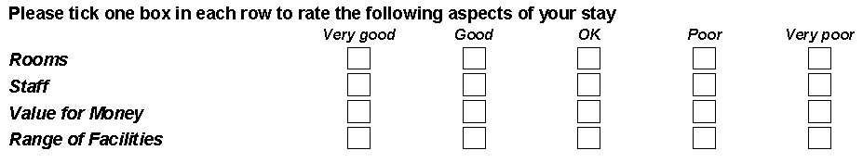

Slide 7
2. Paired Comparison:
In this method, each employee is compared with other employees on one- on one basis only. The rater is provided with a bunch of slips each coining pair of names, the rater puts a tick mark against the employee whom he insiders the better of the two.

Slide 8
In this method, certain categories of worth are
3. Grading Method:
established in advance and carefully defined. There can be three categories established for employees: outstanding, satisfactory and unsatisfactory. The employee is, then, allocated to the grade that best describes his or her performance.
4. Forced Distribution Method:
This method assumes that employees performance level confirms to a normal statistical distribution i.e., 10,20,40,20 and 10 per cent. This is useful for rating a large number of employees’ job performance and promo ability. It tends to eliminate or reduce bias.

Slide 9

Under this method, the rater is forced to answer
5. Forced-Choice Method:
the ready-made statements as given in the blocks of two or more, about the employees in terms of true or false. Once he is done with the list, it is
forwarded to the assessment
HR department for of the
the final employee.

Slide 10

The basic purpose of utilizing check-list method is
6. Check-List Method:
to ease the evaluation burden upon the rater. In this method, a series of statements, i.e., questions with their answers in ‘yes’ or ‘no’ are prepared by the HR department. The check-list is, then, presented to the rater to tick appropriate answers relevant to the appraise. Each question carries a weight-age in relationship to their importance.

Slide 11

The critical incident method requires the rater to
7. Critical Incidents Method:
record statements that describe extremely good or bad behavior related to job performance. The statements are called critical incidents and are
usually recorded by the evaluation period
the supervisor during for each subordinate.
Recorded incidents include a brief explanation of what happened.

Slide 12
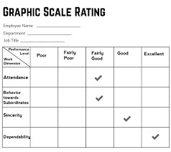
8. Graphic Rating Scale Method:
The graphic rating scale is one of the most popular
and simplest techniques performance. It is also known
for appraising as linear rating
scale. In this method, the printed appraisal form is used to appraise each employee.

Slide 13

Essay method is the simplest one among various
9. Essay Method:
appraisal methods available. In this method, the
rater writes a employee’s
narrative
description on an weaknesses, past
for
strengths,
potential and suggestions
performance,
improvement. Its positive point is that it is simple in use. It does not require complex formats and extensive/specific training to complete it.

Slide 14
This is an appraisal done by someone outside employees, own department usually from corporate or HR department level.
10. Field Review Method:
Advantages: Useful for managerial level promotions, when comparable information is needed. Disadvantages: Outsider is generally not familiar with employees work environment, Observation of actual behaviors not possible.

Slide 15

It is the traditional way of appraising employees
11. Confidential Report:
mainly in Evaluation
the Government Departments. is made by the immediate boss or for giving effect to promotion and
supervisor
transfer. Usually a structured format is devised to
collect information
on employee’s
attitude,
strength character,
weakness, intelligence, attendance, discipline, etc.

Slide 16
B.Modern methods are as
follows.
Management by Objectives (MBO)
Behaviourally Anchored Rating Scales (BARS)
Assessment Centers
360 – Degree Appraisal
Human Resource Accounting

Slide 17
1. Management by Objectives (MBO):
Concept given by Peter F. Drucker .
MBO is not applicable to all jobs in an organization. For example assembly line work.
those workers has so little job flexibility that the performance standards and objectives are already determined.
MBO is useful with managerial personnel and employees who have a wide range of flexibility and self control in their jobs.

Slide 18
Behaviourally Anchored Rating Scales (BARS) are
2. Behaviourally Anchored Rating Scales (BARS):
designed to bring the benefits of both qualitative and quantitative data to the employee appraisal process.
Here, the rater is expected to indicate which behavior on each scale best describe an employee’s performance.
Descriptive statements varying from the least to the most effective.

Slide 19
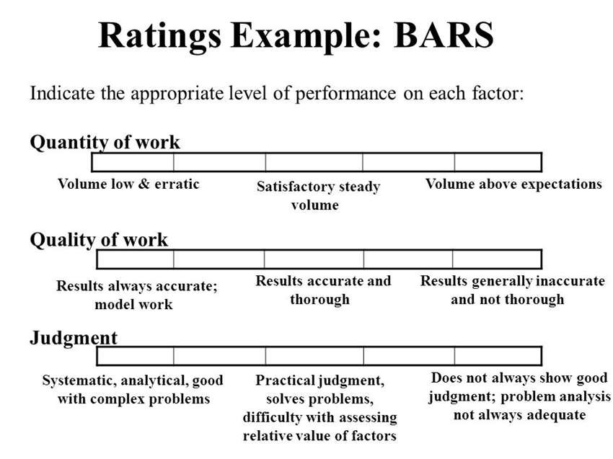

Slide 20
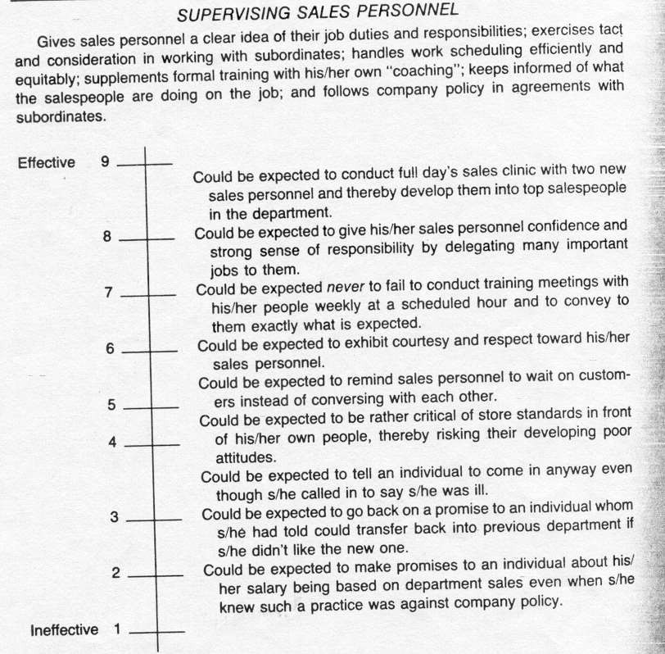

Slide 21

An assessment center is a central location where
3. Assessment Centers:
the managers may come together to participate in
job related exercises evaluated observers. The principle idea is
by trained to evaluate
managers over a period of time, by observing and later evaluating their behaviour.

Slide 22

In 360-degree appraisal system, an employee is
4. 360 – Degree Appraisal:
appraised by his supervisor, subordinates, peers, and customers with whom he interacts in the course of his job performance. All these appraisers provide information or feedback on an employee by completing survey questionnaires designed for this purpose.

Slide 23
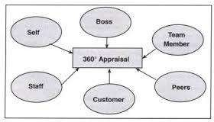
Enables an employee to compare his perception
about self with other’s perception.
Provide formalized communication link between an employee and his or her customers.
effective in identifying and measuring interpersonal skills, customer satisfaction, and team building skills.

Slide 24
Human resource method attaches money values
5. Human Resource Accounting:
to the value of a firms internal human resources and its external customer good will. Under this method, performance is judged in terms of costs and contributions of employees. Difference between the cost and contribution will reflect the performance of the employees.

Slide 25
THE END

